Slide 1
A Replication Report
Lars Vilhuber and David Wasser
Cornell University

Slide 2
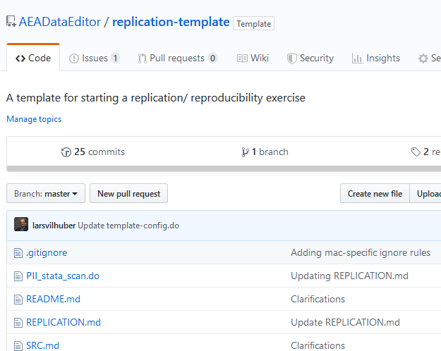
A template
https://github.com/AEADataEditor/replication-template
Accessible to anybody

Slide 3
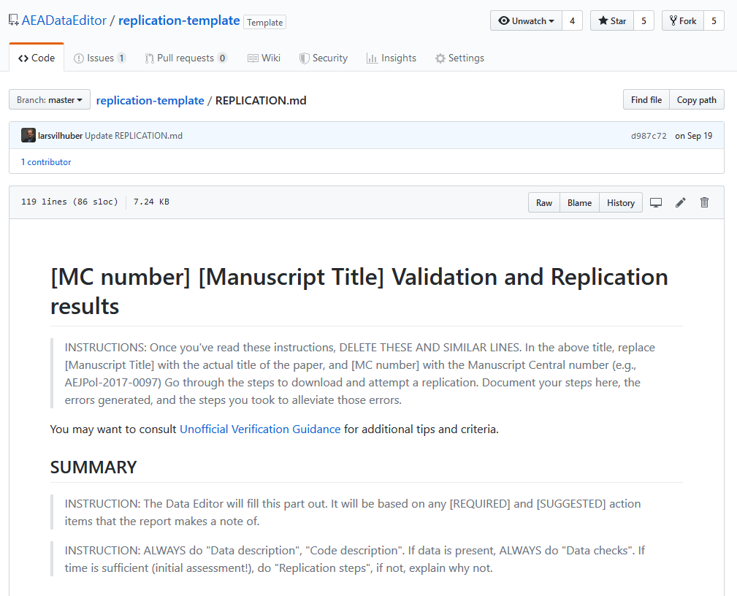
A template
Has a title, referencing the manuscript title and the (Manuscript Central) identifier
Manuscript Central = MC is the manuscript refereeing system the AEA uses (also called ScholarOne)

Slide 4
Structure of the report
SUMMARY
Data description
Data checks
Code description
Replication steps
Computing Environment
Findings
Classification
The SUMMARY is intended for a quick glance by journal editor and authors

Slide 5
Structure of the report
SUMMARY
Data description
Data checks
Code description
Replication steps
Computing Environment
Findings
Classification
The green parts can be done without ever running any code on a computer
Data citations!
Reading the code

Slide 6
Structure of the report
SUMMARY
Data description
Data checks
Code description
Replication steps
Computing Environment
Findings
Classification
The blue parts require
Data
Software
Computing resources
We will discuss the availability of each of those in more detail later

Slide 7
Structure of the report
SUMMARY
Data description
Data checks
Code description
Replication steps
Computing Environment
Findings
Classification
The Classification is a summary judgement of the article
Not always 100% well-defined when parts work, and others are excluded

